Slide 1
Road Sign Detection (Stop and Do Not Enter signs)
Abhishek Gambhir (2011CS1002)
Prakhar Asthana (2011CS1027)
Prateek Singh (2011CS1028)

Slide 2
Description
To detect and recognize the warning sign boards on the road.
Currently for “STOP” and “DO NOT ENTER” sign boards .
Sign recognition is based on
Dimensions of the board
Dimensions of the pattern

Slide 3
Application
Driver is unable to pay full attention all the time.
Attention loss can be due to many reasons like talking, eating etc. while driving.
Our project can help to inform the driver of a vehicle about sign boards.

Slide 4
Algorithm
Obtain the Y Cb Cr components of the image
Threshold Y and Cr.
Dilate(Enlarge) and Erode(Contract) the Cr component.
Multiply the Cr component values with the Y component to separate the sign.
Calculate the height and width ratio of the board and the written text and detect the sign.

Slide 5
Obtaining the Y Cr Cb components
Y = 0.299R + 0.587G + 0.114R
Cr = 0.5R - 0.419G - 0.08B.
Cb = 0.5B - 0.169R - 0.331G
The Y, Cr and Cb components ease the processing of the image.

Slide 6
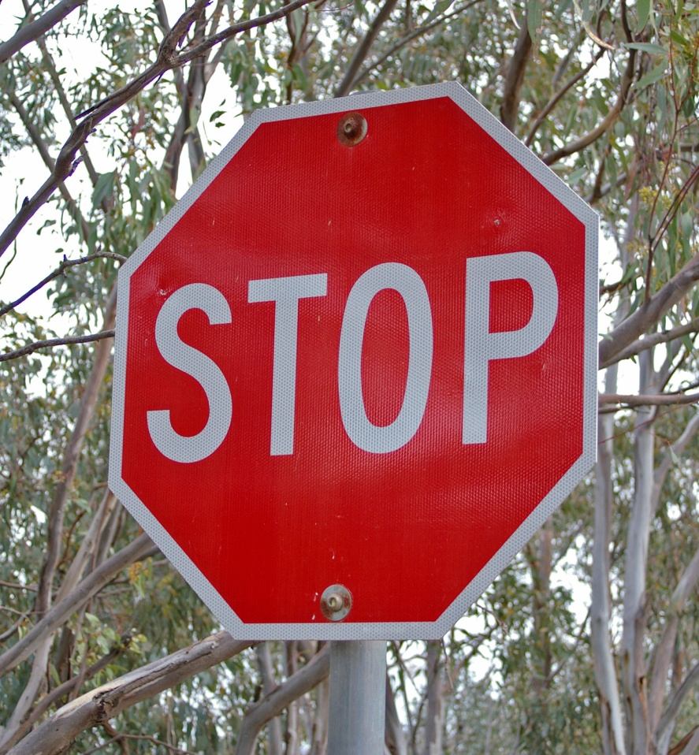
Example image

Slide 7
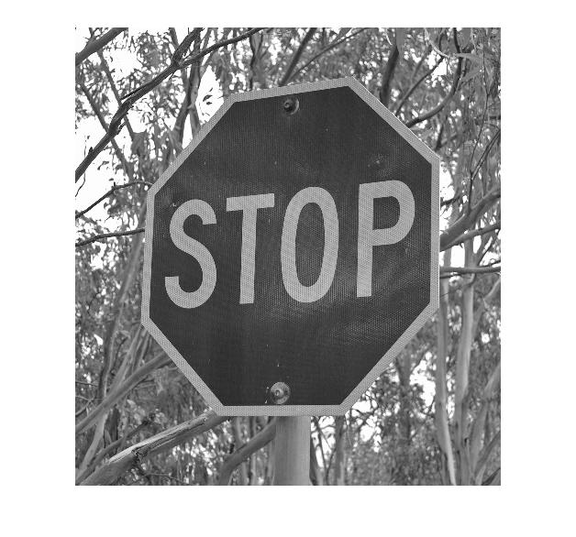
Y component

Slide 8
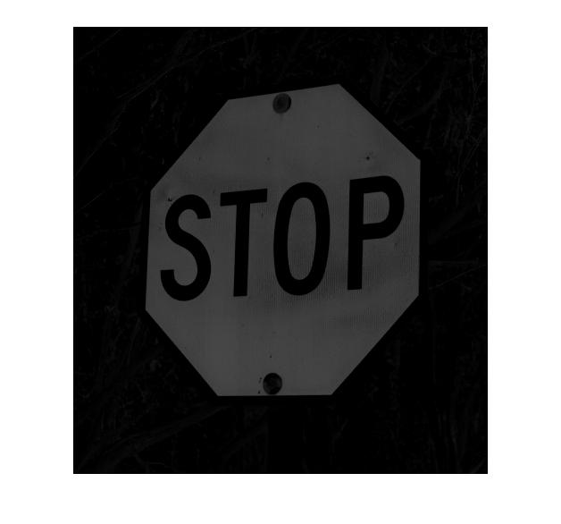
Cr component

Slide 9
Thresholding
Thresholding Y component to 0.56, converts image to binary image.
Average of Y component across the whole image is calculated.
Based on value of average, Cr component of image is thresholded.

Slide 10
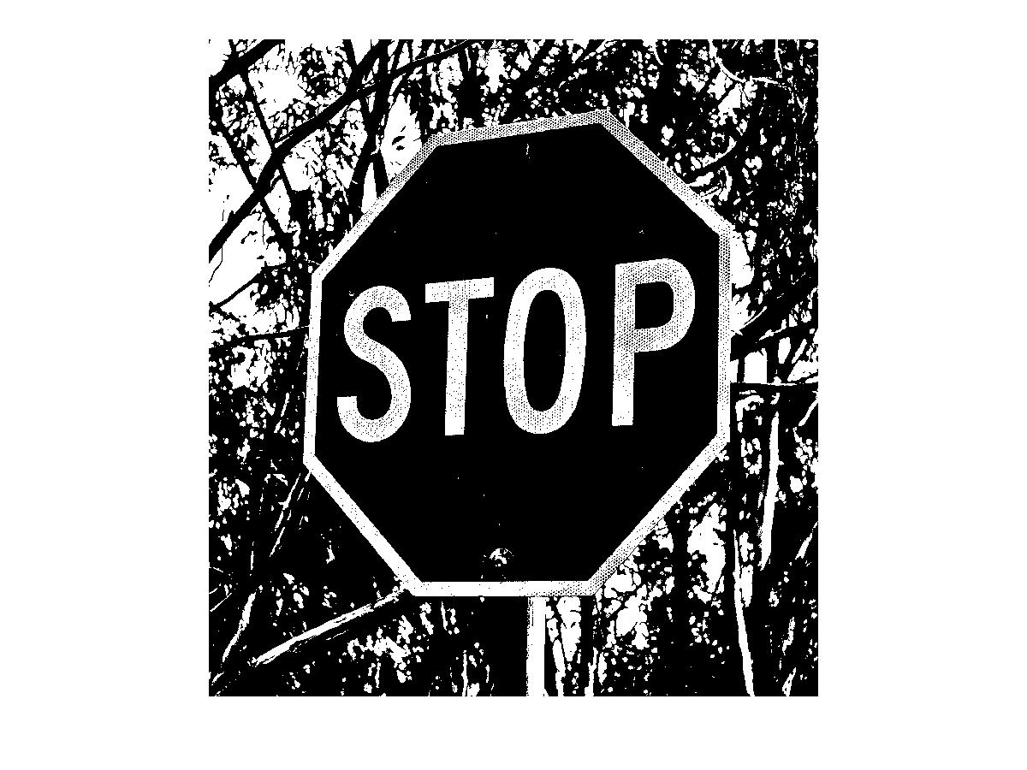
Thresholded Y-component

Slide 11
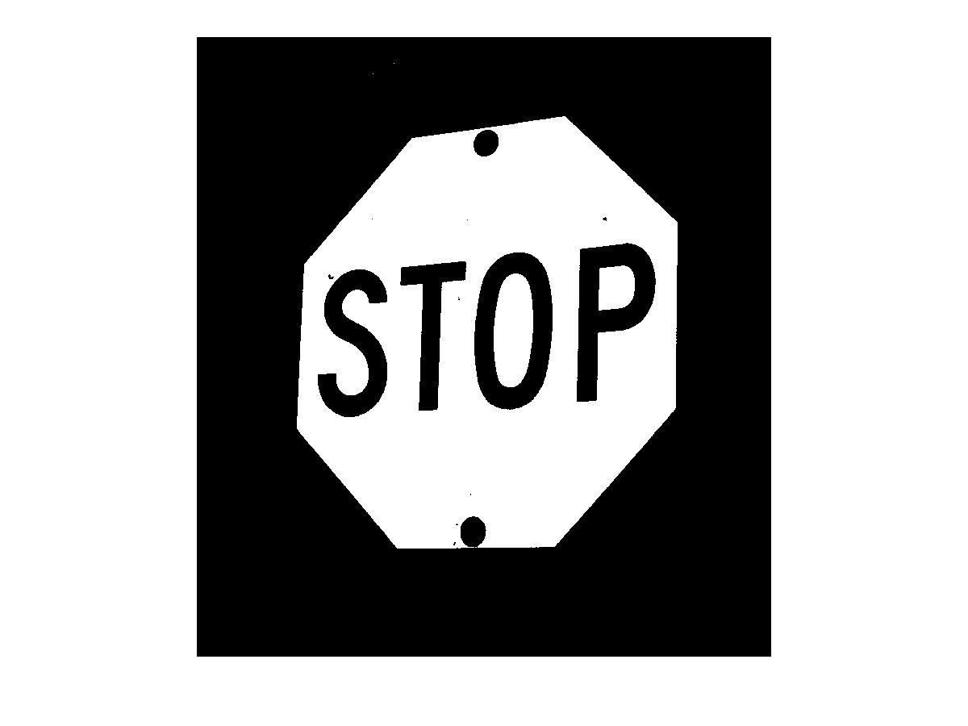
Thresholded Cr-component

Slide 12
Dilation and Erosion
Median filter is applied to the Cr component to remove the salt and pepper noise.
Image is dilated to remove the black portions inside the signboard.
This increases the size signboard.
Image is eroded to counter enlarged size of signboard.

Slide 13


After Dilation
After Erosion

Slide 14
Separating the Sign
The sign written on the signboard is obtained by multiplying (ANDing) the Y component with the dilated + eroded image.

Slide 15
Y-Component
Eroded and Dilated Cr

Slide 16

The result of the AND operation

Slide 17
Detection of the signs
The width and height of the sign are then computed.
Same is done for the signboard.
The ratio of the height of the signboard to that of the sign is computed.
Same is done for the width.
Values obtained are compared to the reference values and the matching sign is identified.

Slide 18
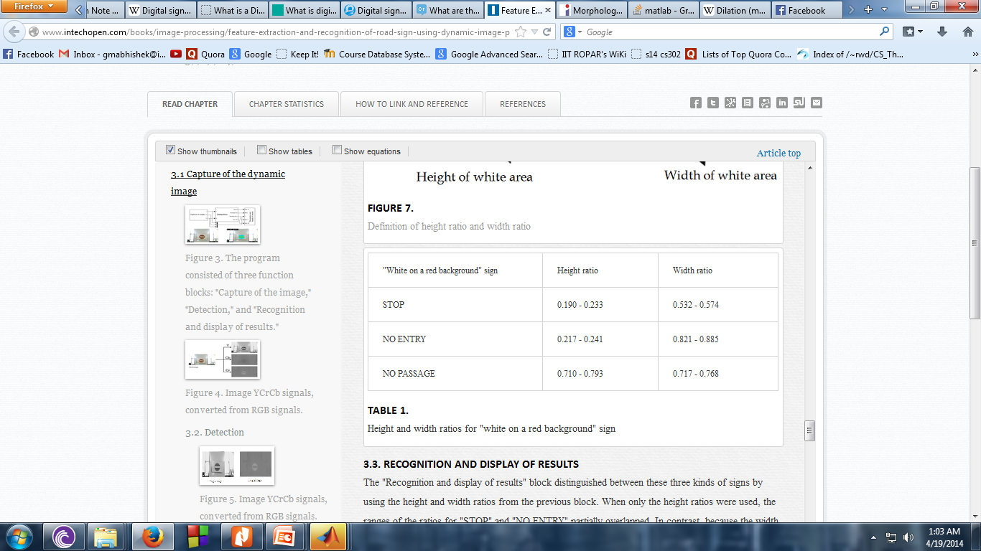
Reference Values

Slide 19
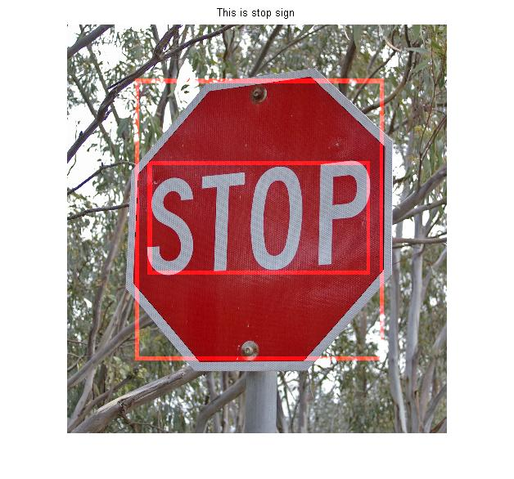
Final image after completion of algorithm

Slide 20
Advantages
Less processing time, as compared to neural networks.
Applicable in real time system.
Other signs can also be detected based on their geometric parameters.
Tilted sign boards can also be detected to some degree .

Slide 21
Limitations
Hard to detect signboard appearing very small in image because ratios cannot be calculated reliably.
Sign boards appearing overlapped in image cannot be detected.
Unable to detect sign, if interior of signboard covers whole image.

Slide 22
Individual Contributions
Prateek Singh:- Coding part.
Prakhar Asthana and Abhishek Gambhir: Came up with the idea for project, and are responsible for all documentations.

Slide 23
References :-
Miyata, Shigeharu, et al. "Feature Extraction and Recognition for Road Sign Using Dynamic Image Processing." Innovative Computing Information and Control, 2008. ICICIC'08. 3rd International Conference on. IEEE, 2008.
Fleyeh, Hasan, and Mark Dougherty. "Road and traffic sign detection and recognition." 10th EWGT Meeting and 16th Mini-EURO Conference. 2005.

